Slide 1
DATA SCIENCE CAPSTONE FINAL PROJECT PRESENTATION Instructor : Sir Alex Aklson , Senior Data Scientist at IBM Made by : Rishi on Coursera
Topic : The Battle of Neighborhood – searching a better place in Scarborough , Toronto

Slide 2
Table of Content
Introduction
Objectives
Data Section
Methodology Section
Workflow
Result Section
About Location
Role of Four Square API
Discussion Section
Conclusion
Future Work

Slide 3
Introduction
The purpose of this Capstone Project is to help people in exploring better facilities around their Neighborhood . It will help people making a smart and efficient decisions on selecting great Neighborhood out of numbers of other Neighborhood in Scarborough, Toranto.
Lots of people are migrating to various states of Canada and needed lots of research for good housing prices and reputed schools for their children. This project is for those people who are looking for better Neighborhood . For ease of accessing to Cafe, School, Super market, medical shops, grocery shops, mall, theatre, hospital, like minded people, etc.

Slide 4
Objective
This Capstone Project aim to create an analysis of features for a people migrating to Scarborough to search a best Neighborhood as a comparative analysis between Neighborhood . The features include median housing price and better school according to ratings, crime rates of that particular area, road connectivity, weather conditions, good management for emergency, water resources both fresh and waste water and excrement conveyed in sewers and recreational facilities.
It will help people to get awareness of the area and Neighborhood before moving to a new city, state, country or place for their work or to start a new fresh life.

Slide 5
Data Section
Data Link: https://en.wikipedia.org/wiki/List_of_postal_codes_of_Canada:_M
Will use the Scarborough dataset which we scrapped from Wikipedia . Dataset consisting of latitude and longitude, zip codes.
Foursquare API Data :
We will need data about different venues in different Neighborhood of that specific borough. In order to gain that information we will use “Foursquare” location information. Foursquare is a location data provider with information about all manner of venues and events within an area of interest. Such information includes venue names, locations, menus and even photos. As such, the foursquare location platform will be used as the sole data source since all the stated required information can be obtained through the API.
After finding the list of Neighborhood , we then connect to the Foursquare API to gather information about venues inside each and every Neighborhood . For each Neighborhood , we have chosen the radius to be 100 meter.

Slide 6
Data Section ( Continue )
The data retrieved from Foursquare contained information of venues within a specified distance of the longitude and latitude of the postcodes. The information obtained per venue as follows:
Neighborhood
Neighborhood Latitude
Neighborhood Longitude
Venue
Name of the venue e.g. the name of a store or restaurant
Venue Latitude
Venue Longitude
Venue Category

Slide 7
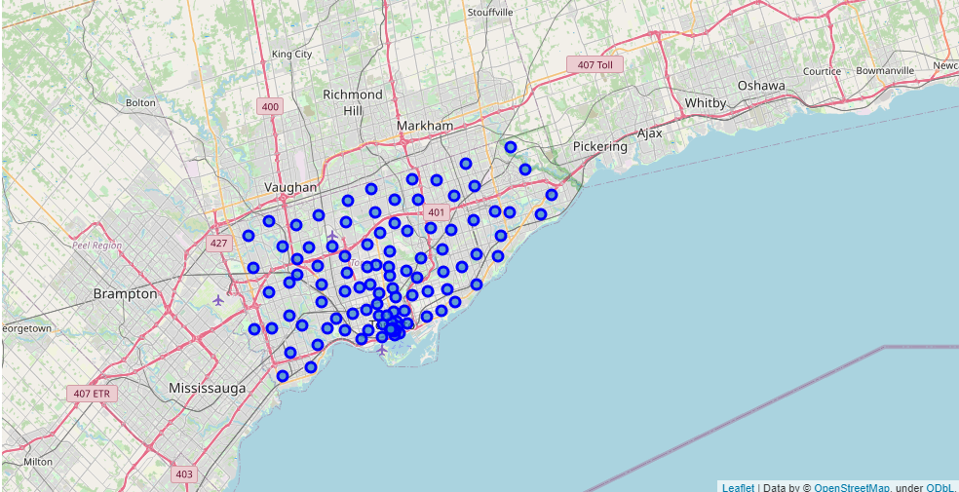
Map of Scarborough

Slide 8
Methodology Section
Clustering Approach : To compare the similarities of two cities, we decided to explore Neighborhood , segment them, and group them into clusters to find similar Neighborhood in a big city like New York and Toronto. To be able to do that, we need to cluster data which is a form of unsupervised machine learning: k-means clustering algorithm.
2nd Method : In order to find the most common venue we will use the K – Means Clustering Approach .

Slide 9
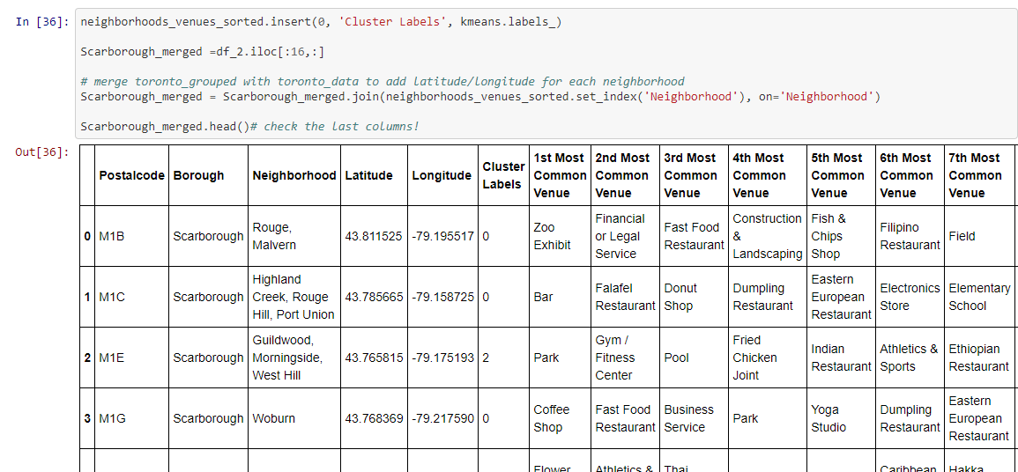
Code for K – Means Clustering

Slide 10
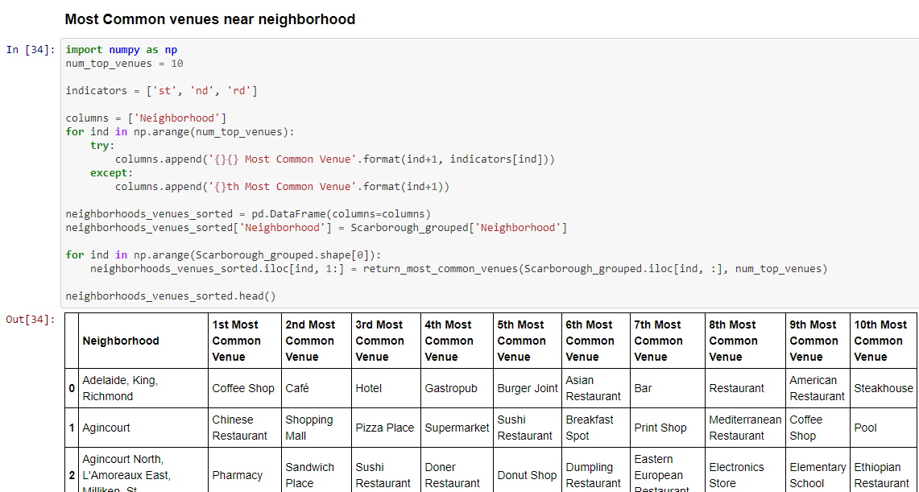
Most Common Venues near Neighborhood

Slide 11
Work Flow
Using credentials of Foursquare API features of near-by places of the Neighborhood would be mined. Due to http request limitations the number of places per Neighborhood parameter would reasonably be set to 100 and the radius parameter would be set to 500

Slide 12
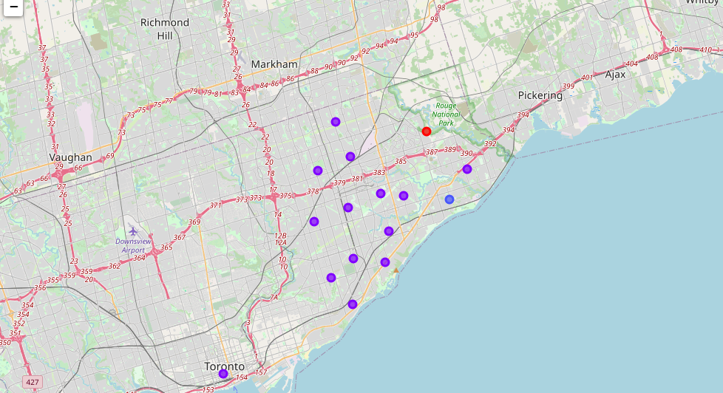
Result Section Map of Cluster in Scarborough

Slide 13
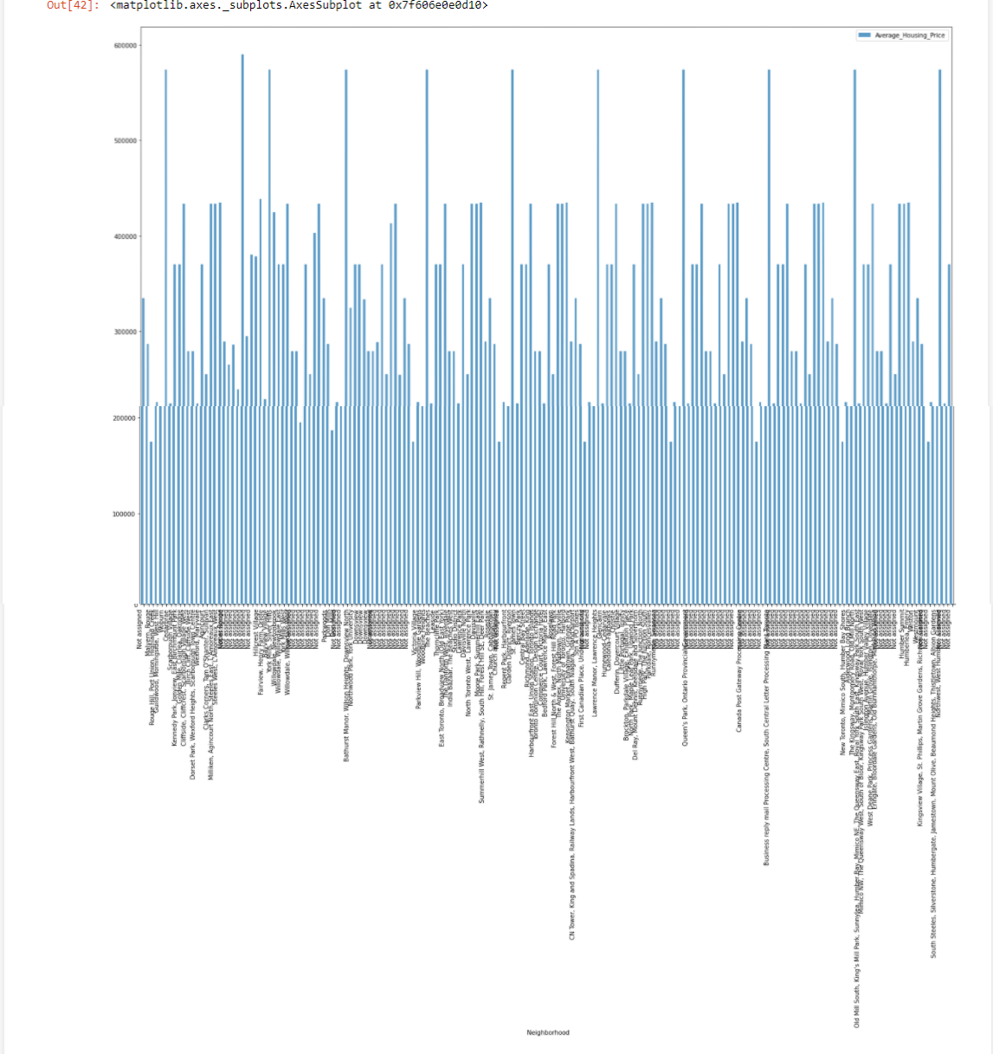
Average Housing Price by Clusters in Scarborough

Slide 14
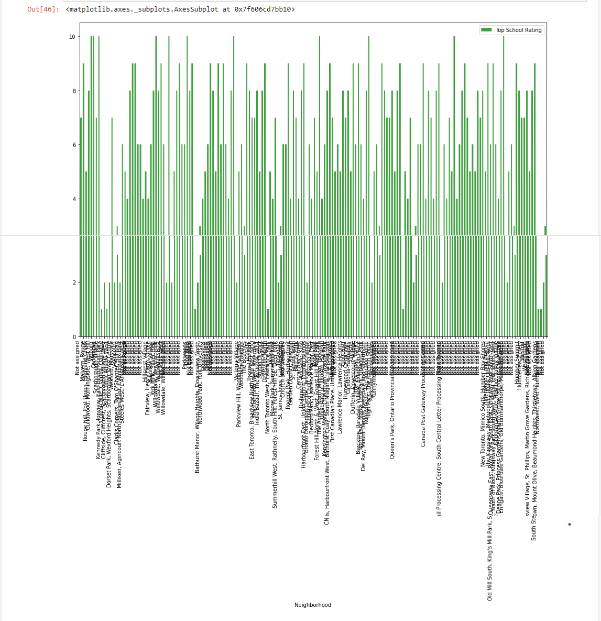
School Rating by cluster in Scarborough

Slide 15
About the Location
Scarborough is a popular destination for new immigrants in Canada to reside. As a result, it is one of the most diverse and multicultural areas in the Greater Toronto Area, being home to various religious groups and places of worship. Although immigration has become a hot topic over the past few years with more governments seeking more restrictions on immigrants and refugees, the general trend of immigration into Canada has been one of on the rise.

Slide 16
Role of Foursquare API
This Capstone project have used Four-square API as its prime data gathering source as it has a database of millions of places, especially their places API which provides the ability to perform location search, location sharing, and details about a business.

Slide 17
Discussion Section
Problem Which Tried to Solve :
The major purpose of this project is to suggest a better Neighborhood in a new city for the person who is shifting there. Social presence in society in terms of like-minded people. Connectivity to the airport, bus stand, city centre , markets, and other daily needs things nearby.
Sorted list of the house in terms of housing prices in an ascending or descending order
Sorted list of schools in terms of location, fees, rating, and reviews

Slide 18
Conclusion Section
In this Capstone project, using the k-means cluster algorithm I separated the Neighborhood into 10(Ten) different clusters and for 103 different latitudes and longitude from the dataset, which has very-similar Neighborhood around them . Using the charts above results presented to a particular Neighborhood based on average house prices and school ratings have been made.
I feel rewarded with the efforts and believe this course with all the topics covered is well worthy of appreciation .
This project has shown me a practical application to resolve a real situation that has impacting personal and financial impact using Data Science tools. The mapping with Folium is a very powerful technique to consolidate information and make the analysis and decision better with confidence.

Slide 19
Future Work
This Capstone project can be continued for making it more precise in terms to find the best house in Scarborough. Best means on the basis of all required things(daily needs or things we need to live a better life) around and also in terms of cost-effective.

Slide 20
Thanks for checking A Very Happy New Year To The all Reader PPT Completed on : 1st January 2021

